Slide 1
Tertiary Structure
Tertiary structure describes how the secondary structure units associate within a single polypeptide chain to give a three-dimensional structure.
Quaternary structure describes how two or more polypeptide chains associate to form a native protein structure (but some proteins consist of a single chain).
Tertiary structures can be divided into three main classes:
α domain
β domains
α/β domains

Slide 2
(Domain) Folds of Protein

Slide 3

Common Features of Globular Proteins
The non-polar residues V, L, I, M and F largely occur in the interior of a protein, out of contact with the aqueous solvent.
The charged polar residues R, H, K, D and E are largely located on the surface of a protein in contact with the aqueous solvent. If they are located inside of a protein, they often have specific chemical function, such as promoting catalysis or participating in metal binding.
The uncharged polar groups S, T, N, Q, Y and W are usually on the surface but frequently occur in the interior of the protein, forming hydrogen bonds with other groups.
Globular protein cores are efficiently arranged with their side chains in relaxed conformations. The protein interior is efficiently packed .

Slide 4
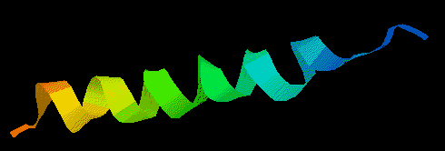
Alpha Domain: The Lone Helix
There are a number of examples of small proteins (or peptides), which consist of little more than a single helix.
A striking example is glucagon, a hormone involved in regulating sugar metabolism in mammals (as is insulin).

Slide 5
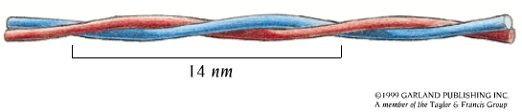
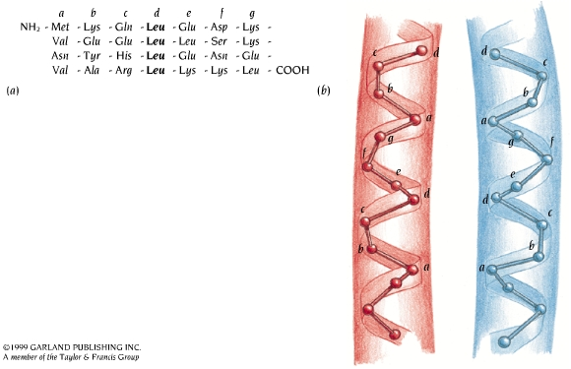

Coil-coil α Helices
A coiled-coil α helix has a repetitive heptad amino acid sequence (transcription factor GCN4). Within each heptad the amino acids are labeled a-g.
The α helices in the coiled-coil are slightly distorted so that the helical repeat is 3.5 residues rather than 3.6, as in a regular helix. There is an integral repeat of seven residues along the helix.

Slide 6
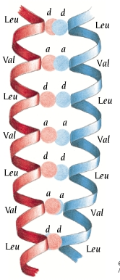
Packing of a Coil-coil
Every seventh residue in both α helices is a leucine, labeled “d”.
Due to the heptad repeat, the d-residues pack against each other along the coiled-coil.
Residues labeled “a” are also usually hydrophobic and participate in forming the hydrophobic core along the coiled-coil.

Slide 7
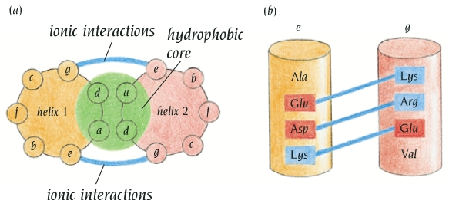
Heptad Repeats.
Salt bridges can stabilize coiled-coil structures and are sometimes important for the formation of heterodimeric coiled-coil structures. The residues labeled “e” and “g” in the heptad sequence are close to the hydrophobic core and can form salt bridges between the two α helices of a coiled-coil structure, the e-residue in one helix with the g-residue in the second and vice versa.

Slide 8
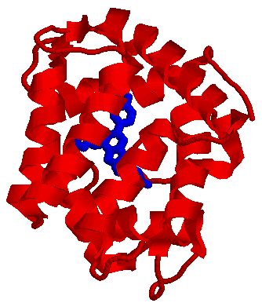
Aequorin
Calcium dependent protein from jellyfish
Successfully expressed in the cell and can be targeted to specific cell subcompartments
Requires a fluorescent cofactor, which is consumed, to be injected into the cell
1EJ3

Slide 9
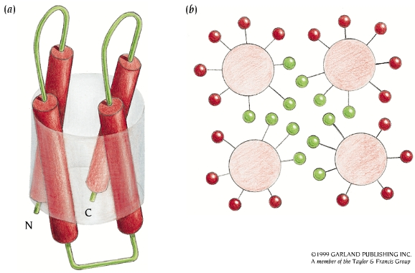
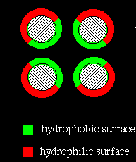
Four-helix Bundles
Four-helix bundles frequently occur as domains in α proteins.
The arrangement of the α helices is such that adjacent helices in the amino acid sequence are also adjacent in the three-dimensional structure.
Some side chains from all four helices are buried in the middle of the bundle, where they form a hydrophobic core.

Slide 10
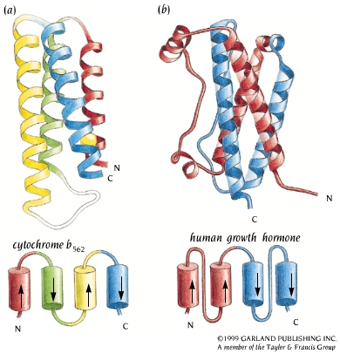
Four-helix Bundles
In cytochrome b562 (a) adjacent helices are antiparallel, whereas the human growth hormone (b) has two pairs of parallel α helices

Slide 11
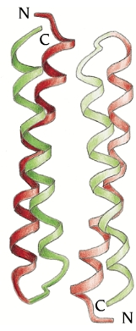
Dimeric RNA-binding Protein Rop
Each subunit of Rop comprises two α helices arranged in a coiled-coil structure with side chains packed into the hydrophobic core according to the "knobs in holes" model.
The two subunits are arranged in such a way that a bundle of four α helices is formed.
The RNA binding surface is located at the middle of the helices.
RNA
RNA

Slide 12
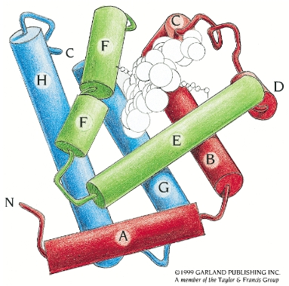
The Globin Fold
This fold has been found in a large group of related proteins including myoglobin and hemoglobin.
The globin fold usually consists of eight alpha helices (A-H). The two helices at the end of the chain are antiparallel, forming a helix-turn-helix motif, but the remainder of the fold does not include any characterized supersecondary structures.
These helices pack against each other with larger angles, around 50 ° between them than occurs between antiparallel helices (approximately 20°) so that the helices form a hydrophobic packet for the heme active site.

Slide 13
The Globin Fold has been Preserved During Evolution
The 3D structures of globin proteins from different organisms (mammals, plants, and inserts) are solved and they share the same essential features of the globin fold.
The sequence homology is from 99 % to 16 %, which is very low.
How can amino acid sequences that are very different for proteins be very similar in their 3D structures?

Slide 14
Evolution of Globins
Arthur Lesk & Cyrus Chothia in the UK have examined the residues that are structurally equivalent to positions in 9 known globin structures, that are involved in helix-heme contacts, and in the packing of the helices against each other.
There are a total of 59 positions preserved, 31 buried in the middle of protein and 28 in contact with the heme group.
There is no conserved sequences nor size-compensatory mutations in the hydrophobic core formed by the 31 a.a.
Conclusion: The evolutionary divergence of globins has been constrained primarily by an almost conservation of the hydrophobicity of the residues buried in the helix-helix and helix-heme contact.

Slide 15
How do Proteins Adopt to Changes in the Size of Buried Residues?
The mode of packing for the α helices are the same in all the globin structures
The same types of packing ridges into grooves occur in corresponding α helices in all these structures.
The relative positions and orientations of the α helices change to accommodate changes in the volume of sidechains involved in the packing.
The structure of loop regions changes so that the movement of one helix is not transmitted to the rest of the structure to preserve the geometry of the heme pocket.

Slide 16
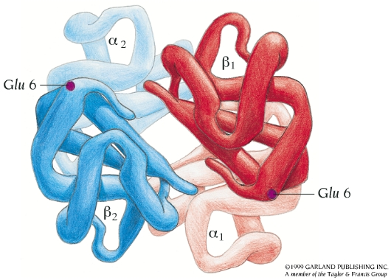
Hemoglobin
The hemoglobin molecule is built up of four polypeptide chains: two α chains and two β chains. Each chain has a three-dimensional structure similar to that of myoglobin: the globin fold.
In sickle-cell anemia, Glu 6 in the β chain of hemoglobin is mutated to Val, thereby creating a hydrophobic patch on the surface of the molecule.

